Slide 1
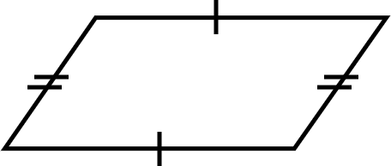
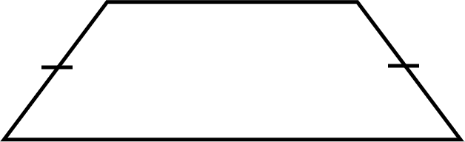
Problem solving with perimeter and area
Task A: Using one to find the other
1) Calculate the area.
2) Calculate the perimeter.
4 units
6 units
5 units
6 units
13 units
The perimeter of this shape is 31 units.
The area of this shape is 63 units².
Perimeter = 6 + 6 + 2 × base
31 = 12 + 2 × base
19 = 2 × base
9.5 = base
Area = base × perpendicular height
Area = 9.5 × 4
Area = 38 units²
Area = ½ × (a + b) × h
63 = ½ × (a + 13) × 6
63 = 3 × (a + 13)
21 = a + 13
8 = a
Perimeter = 8 + 13 + 2 × 5
Perimeter = 31 units
Task B: Perimeter and area in context
1) Alex’s garden is an unusual shape. He wants to put a fence around it. What is the total length of fencing he needs to buy?
Perimeter is needed here - Alex talks about length and the context is fencing which goes around the garden.
Total length of fencing = 2 × 10 + 2 × 7
Total length of fencing = 34 m
4 m
10 m
7 m

Slide 2
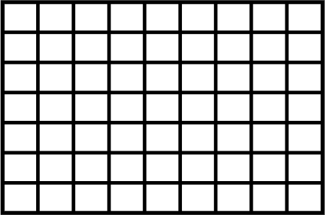
Problem solving with perimeter and area
2) a) Jun is a painter. They want to create a mural. How much space will the mural take up?
b) The rectangular wall Jun plans to paint on measures 21 cm by 38 cm. Will the mural fit on the wall? Justify your answer.
26 cm
21 cm
38 cm
If we calculate the area of the wall, we see it is 21 × 38 = 798 cm². This is the same area as the mural, so we might think it will fit.
However, the wall measures 21 cm by 38 cm. The longest measurement of the mural is 50 cm. If we draw this out on paper, we can see that the mural is simply too big.
50 cm
Area is needed here - we want to know how much space is being covered.
Area = ½ × (26 + 50) × 21
Area = 798 cm²
Task C: Units of measurement
1) Andeep’s sister wants to tile a wall in her bathroom. The wall is rectangular and measures 3 m by 4.5 m.
Each tile is a square which measures 50 cm by 50 cm.
How many tiles will she need to use to cover the wall?
E.g.
One tile has an area of 50 × 50 = 2500 cm².
The wall has an area of 300 × 450 = 135000 cm².
Therefore 135000 ÷ 2500 = 54 tiles will be needed.
Checking the answer:
4.5 m
Each tile is 0.5 m by 0.5 m.
9 tiles fit along the 4.5 m side.
6 tiles fit along the 6 m side.
9 × 6 = 54 tiles
3 m
Mathematics in Education and Industry.

